Slide 1
Data Sources
Data Set | Source | Date Range | Frequency | Period
Median House Price By Year – Houses By Suburb | https://www.land.vic.gov.au/valuations/resources-and-reports/property-sales-statistics | 2012 to 2022 | Annual | 1st Jan to 31st Dec
Population by Suburb | https://api.data.abs.gov.au/files/ABS_ERP_ASGS2021_1.0.0.csv | 2001 to 2021 | Annual | 1st Jul to 30th Jun
School Locations | https://discover.data.vic.gov.au/dataset/school-locations-2022 | As at 5th Aug 2022 | Snapshot | As at 5th Aug 2022
Crime Rates | https://www.crimestatistics.vic.gov.au/crime-statistics/latest-victorian-crime-data/download-data | 2014 to 2023 | Annual | 1st Apr to 31st Mar
Supermarkets, Police Stations and Hospitals | https://www.geoapify.com/ | July 2023 | Snapshot | July 2023

Slide 2
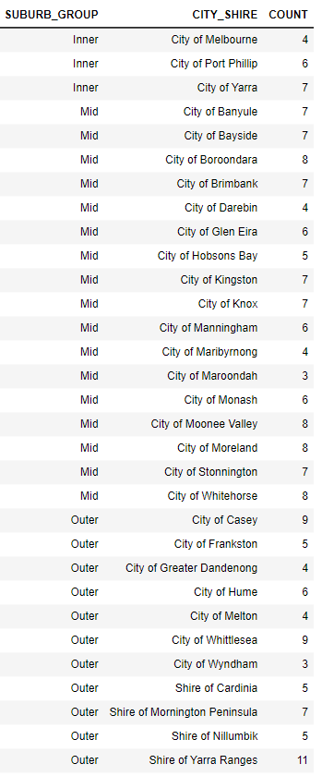
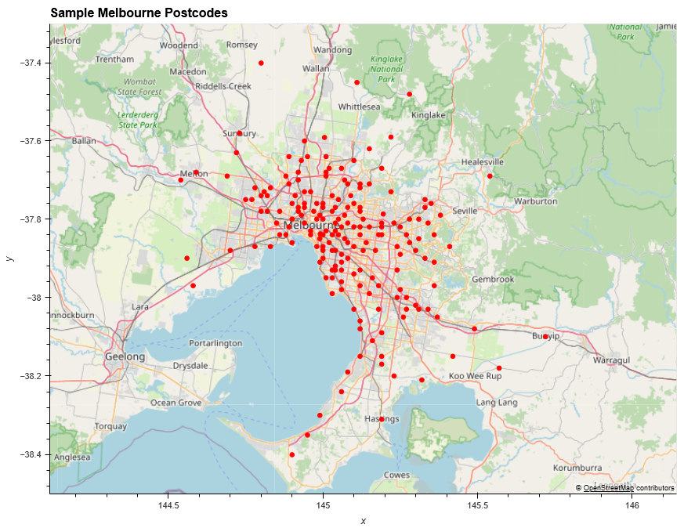
Melbourne Postcodes Sample size = 192
Sample chosen based on available data points from the various data sources.
Restricted to City-Shires within Melbourne

Slide 3
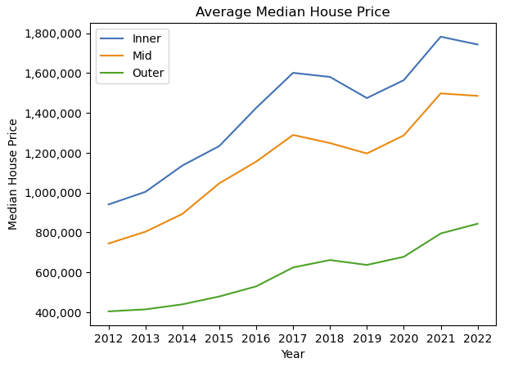
Median House Price – which postcodes are most affordable?
Upward trend in median house price from 2012 to 2022
Impact of covid apparent on all areas of Melbourne
Decline in Median House Price For Inner and Mid areas, whereas Outer increasing from 2021 to 2022
????
covid

